Slide 1
Technical Seminar
Department Of Computer Science and Engineering
Accredited by NBA 2022-2025
BLUE BRAIN TECHNOLOGY
Madhu Sudhan S 1DT19CS074
Guide : MR. Sreenidhi B S
Designation: Associate Prof, Dept of CSE

Slide 2
Introduction
Human brain, the most valuable creation of God. The man is called intelligent because of the Brain. But we loss the knowledge of a brain when the body is destroyed after the death .
“BLUE BRAIN”- The name of the world’s first virtual brain. That means a machine that can function as human brain.
Virtual brain is an artificial brain, which does not actually the natural brain, but can act as the brain. It can think like brain, take decisions based on the past experience, and response as the natural brain can.
Is it really possible to create a human brain?
“YES", the IBM & EPFL is now developing a virtual brain known as the BLUE BRAIN.
Technology is growing faster than everything. If possible, IBM’S “blue brain”, an artificial brain that can think, respond, take decision, and keep anything in memory, would be the first virtual brain of the world.
the goal is to reverse engineer the brain into a computer

Slide 3
What Is Blue Brain?
The Blue Brain Project is assumed to be the first one to explore about a true “Artificial Intelligence” via the process of reverse engineering and also the effort to reverse engineering a human brain.
The vision behind Virtual Brain will help shed some light on some aspects of human recognition. The Blue Brain Project aims to build a full computer model of a functioning brain to simulate drug treatments or any other brain related problems.
Blue gene supercomputer constructed by IBM was a machine first used by Blue Brain Project and then a term Blue Brain was introduced. It can be implemented by using supercomputer, the fastest type but quite expensive and are assist for special tasks which require abundant amount of mathematical computations, like weather forecasting employs a supercomputer.
The back pane of Blue Brain is Artificial Intelligence, a technology which builds intelligent machines and imparts intelligent agents. Knowledge, learning, reasoning, planning, communication and perception are the main goals of its research.

Slide 4
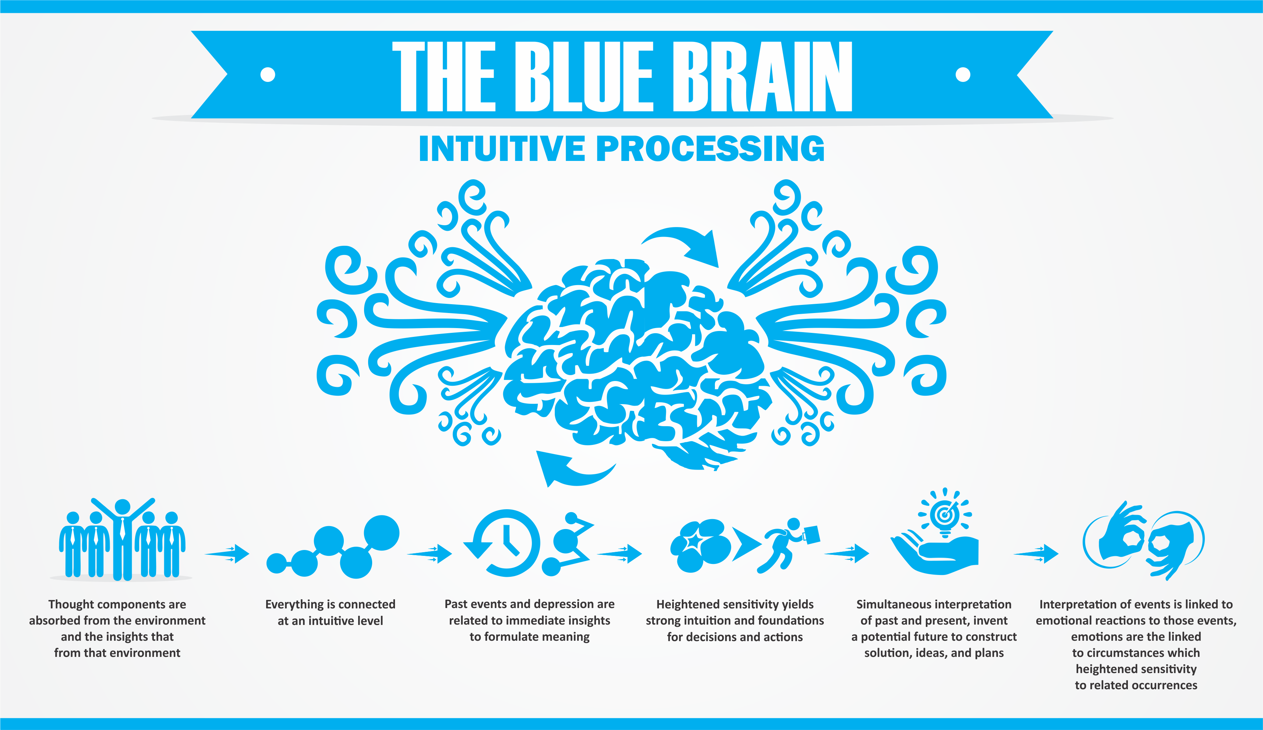
How Natural Brain Works?

Slide 5
How Natural Brain Works?
The brain essentially serves as the body’s information processing center. It receives signals from sensory neurons (nerve cell bodies and their axons and dendrites) in the central and peripheral nervous systems, and in response it generates and sends new signals that instruct the corresponding parts of the body to move or react in some way. It also integrates signals received from the body with signals from adjacent areas of the brain, giving rise to perception and consciousness. The brain weighs about 1,500 grams (3 pounds) and constitutes about 2 percent of total body weight. It consists of three major divisions;
The massive paired hemispheres of the cerebrum
The brainstem, consisting of the thalamus, hypothalamus, epithalamiums, sub thalamus, midbrain, pons, and medulla oblongata
The cerebellum.

Slide 6
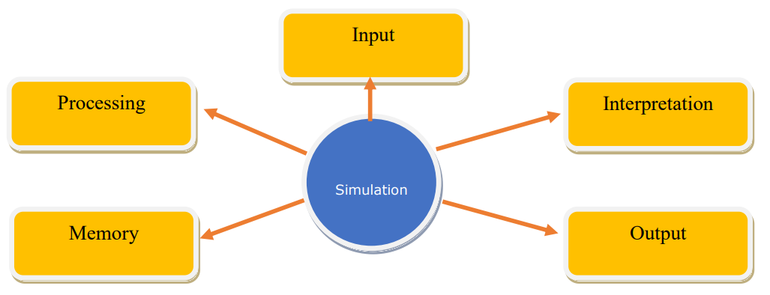
SIMULATION

Slide 7
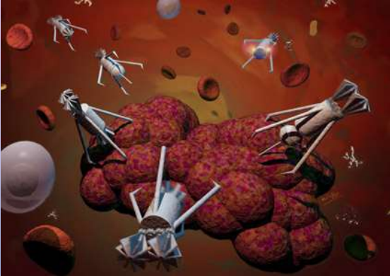
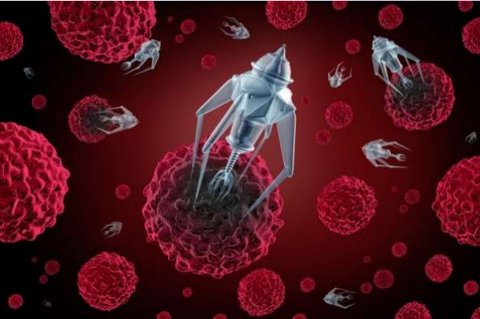
UPLOADING HUMAN BRAIN
The uploading is possible by the use of small robots known as the nanobots.
These robots are small enough to travel throughout our circulatory system.
will monitor activity of brain by traveling into the spine and brain
They will provide an interface with computer
NANOBOTS could also carefully scan the structure of our brain, providing a complete readout of the connection.
This information, when entered into a computer, could then continue to function as us
Thus the data stored in the entire brain will be uploaded into the computer.
NANOBOTS

Slide 8
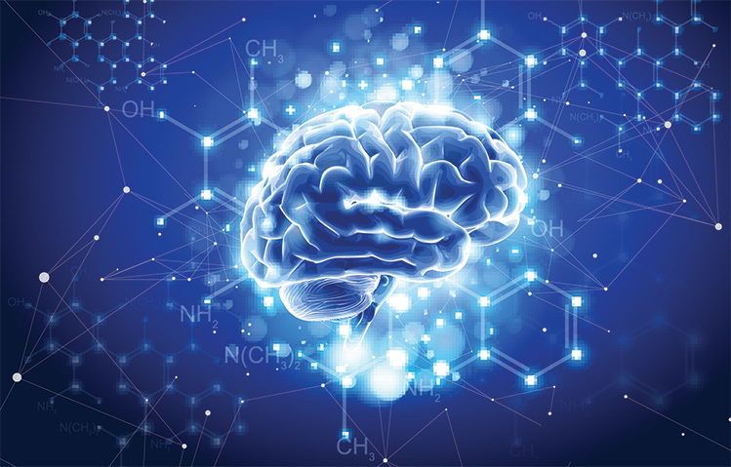
BLUE BRAIN POWER
Blue brain will reveal many existing aspects of the brain circuits ,memory capacity , and how memories are lost.
The modelling is also able to work out best way to compensate and repair error circuits .
The blue brain model can be used to detect and test treatment strategies for neurological diseases.

Slide 9
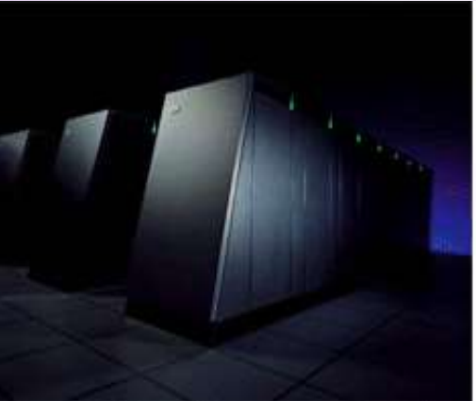
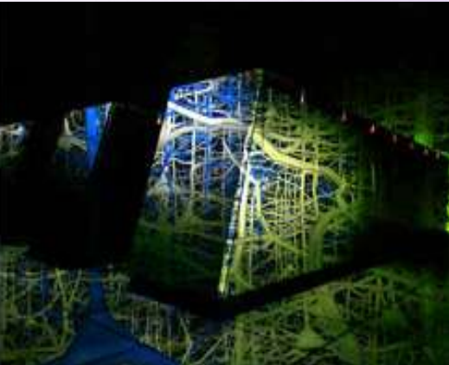
BLUE BRAIN PROJECT
THE IBM’S BLUE BRAIN AT LAUSANNE SWITZERLAND
IBM’S blue brain project will search for insights into how human beings think and remember.
scientists think that blue brain could also help to cure the Parkinson's disease.
the brain circuitry is in a complex state of flux, the brain rewiring itself every moment of its existence. if the scientists can crack open the secret of how and why the brain does it, the knowledge could lead to new breed of supercomputers.

Slide 10
UPLOADING HUMAN BRAIN
Advantages -
blue brain is an approach to store and utilize human intelligence and information present in the mind even after human demise.
it is an important move towards self -decision making by the computer or machine that holds a blue brain.
business analysis, attending conferences, reporting, etc. are very significant functions that an intelligent machine can do consistently..
Disadvantages -
We become dependent upon the computer systems.
Others may use technical knowledge against us.
Computer viruses will pose an increasingly critical threat.
Possibilities of human cloning

Slide 11
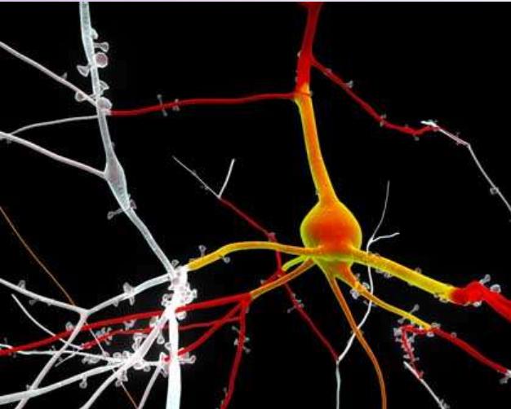
BLUE BRAIN SIMULATION USING MICROPROCESSOR
The Blue Brain simulation uses one microprocessor for each of the 10,000 neurons in the cortical column of a rat's cerebral cortex.
It helps to build a brain microcircuit, in order to scale it in human brain.

Slide 12
BENEFITS OF BLUE BRAIN
it acts as a supercomputer.
improvements in processing , speed and memory could make entire human brain simulated.
things could be remembered without any effort.
use the intelligence of the person after death.
it can make decisions entirely of its own.
allowing the deaf to hear via direct nerve simulation.

Slide 13
Applications
Gathering and testing 100 years of data
Cracking the Neural Code
Understanding Neocortical Information Processing
A Novel Tool for Drug Discovery for Brain Disorders
A Foundation for Whole Brain Simulations
A Foundation for Molecular Modeling of Brain Function

Slide 14
Challenges
Neural Complexity:
Complex dendritic computations affect the probability and frequency of neural firing.
Scale
A massive system is required to emulate the brain: none of the projects we discuss have come close to this scale at present.
Interconnectivity
Emulation of the cortex in hardware represents a massive “wiring” problem.
Plasticity
The strength of the excitatory or inhibitory connection must change with learning, and neurons must also be able to create new synapses
Power consumption
A final, indirect problem is the power consumed by a brain emulation with 50 billion neurons and 500 trillion connections,

Slide 15
Conclusion
We will be able to transfer ourselves into computers at some point.
It will bring both benefits and harm to human society .
Eventually aim of applying terrific computer power to the simulation of an entire brain.
Very soon this technology will be highly accepted all over the world.

Slide 16
References
[1] The Blue brain project, Hill, Sean: Markham Henry, International conference of IEEE 2008.
[2] Henry Markram, "The Blue Brain Project", Nature Reviews Neuroscience, 7:153-160, 2006 February.
[3] Reconstructing the Heart of Mammalian Intelligence, Henry Mark ram’s lecture, March 4 2008.
[4] Henry Mark ram builds a brain in supercomputer, TED conference July 2009
[5] “Research paper 2014 Fourth International Conference on Communication Systems and Network Technologies by Swati Sharma, Nitisha Payal, Ankur Kaushik, Nitin Goel from MIET, Meerut”

Slide 17
Thank you

